Slide 1
Snowshoeing Field Trip - 5 Lesson Learning Design By: Tiffany Kearns EDCI 565
Notes:
I’m Tiffany, I work for School District 43 in Continuing Education with the LINC Program. My learning design is a unit to prepare for a snowshoeing field trip with my class.

Slide 2
LINC (Language Instruction for Newcomers to Canada)
Adults
EAL, Settlement in Canada
Multicultural Mix
Field Trips - Article: Picturing Recreation: Newcomers’ Perspectives on Experiences of Recreation
Experiential Learning and technology
Notes:
LINC stands for Language Instruction for Newcomers to Canada. The students are adults, some as young as their early 20s and I’ve had students in their 70s before, so it can be quite a range. They are learning English as an additional language – for many it is their 3rd or 4th language and they are also learning about Canada. At the moment I have students from different areas of China, South Korea, Afghanistan, Iran, Vietnam, Ukraine, Mexico, and even one from South Sudan, so it’s a really fun multicultural group. One of the mandates of the program is that we do field trips each month, so it can be challenging for both teachers to organize and students to see the value in, so I’m interested in how to improve this in my practice and how to connect the field trip experience with technology – which I try to do throughout my design, but in particular in the final lesson. I got this idea from an article called “Picturing Recreation: Newcomers’ Perspectives on Experiences of Recreation” in which the students participated in Photovoice activities to find out how they develop a sense of belonging and connection to their new culture through leisure. And as I read more about experiential learning I started to see a connection where experiential learning focuses on learners reflecting on their experience of doing something, so as to gain insight as well as practical expertise. And so I’m interested in connecting how experiential learning can be designed and delivered, with the use of technology, and in ways that help develop the digital literacy needed for my adult learners in today’s world.

Slide 3
Other Requirements
CLBs (Canadian Language Benchmarks)
4 skills (listening, speaking, reading, writing)
Portfolio – 2 assessments/week
Real World Tasks – According to Chametzky (2018), “When real-world examples are given by the educator, two things take place. First, the learner develops ties with the subject material because he or she sees a real-world practicality with the material. Second, the student creates stronger ties to the subject matter because of past experiences”(p.95).
Notes:
There are a few other requirements for LINC in terms of learning design and assessment. Teachers need to follow the Canadian Language Benchmarks – I’ve got a link here so you can check them out later if you want, but as their name implies, they are benchmarks or what students should be able to do in the 4 skills of listening, speaking, reading and writing. And since my level is LINC 5, which is a lower intermediate level on the scale, that is what I go by. And we are also required to use mostly what they call real world tasks – especially for assessment. We do lots of formative assessment, but the students are required to keep a portfolio of more formal/summative type assessments and for a fulltime class, which mine is, we should do 2 per week. One article I came across helped me to understand why these real world tasks are so important. It’s called The Interconnectedness of Learning: How Andragogy Can Improve the Online Learning Experience, where the author states that when learners interact with real world tasks, they develop ties with the material because they see it as practical, and they also connect to it because of their past experiences.

Slide 4
Goals and Learning Outcomes
Understand safety and helpful tips for beginners
Appreciate the history of the snowshoe
Think critically about potential problems that could arise while snowshoeing
Reflect on and share the experience
Try a new program - Microsoft Sway
Notes:
: So in the design I came up with the first two lessons will deal with a bit of safety – what to wear and tips for beginners. The third one will look at the history - Indigenous origins to modern pastime. The 4th focuses on potential problems that can arise while snowshoeing. Then we will have our trip to Grouse Mountain in North Vancouver to actually try snowshoeing – we are crossing our fingers that the snow stays until the end of the week. And then for the final lesson I want to try photovoice – to give the students a chance to post and share a photo and reflection of their experience. And to practice more digital literacy, this time I tried to use Microsoft Sway. So this was a personal challenge to expand my digital knowledge and then show the students how to navigate the lessons on the Sway – and so far they have been doing well. This also works well so students can progress through the lessons if by chance they miss one – it’s easy to follow and provides flexibility.

Slide 5
Lesson 1
What To Wear In Winter on ellii.com
Paid program
All 4 skills – listening, speaking, reading, writing
Real world
Video
Article modified from the Associated Press
Photo by Kelly Sikkema on Unsplash
Notes:
For the first lesson I chose something from ellii.com which is a paid program but very useful if you ever teach teens or adults. This one touched on all the skills and to connect to real world I try to choose lessons with articles that have been modified from a real world publication.

Slide 6
Lesson 1
Behaviorist – practice and immediate feedback
Formative Assessment
Notes:
Slide 6: The students work through vocabulary matching, a video, a reading and then questions. I usually let them do the vocab on their own, the video and reading together, and then the questions on their own again – they all go at different paces so it works well, and when they submit I can give them quick formative feedback. You can see an example here. Sometimes I ask them to try again.

Slide 7
Lesson 2
Tips For Snowshoe Beginners
Quizlet – paid and free versions
Real world - YouTube Video
Microsoft forms
Listening and writing skill focus
Photo by Ali Kazal on Unsplash
Notes:
Slide 7: The second lesson uses quizlet – one of my favorites for vocab, a YouTube video – where the speakers are actually at Grouse Mountain where we will go and the sound isn’t perfect, so very real world. And then Microsoft forms where they will have to write the tips from the video that they find most helpful. So there is a listening and writing focus.

Slide 8
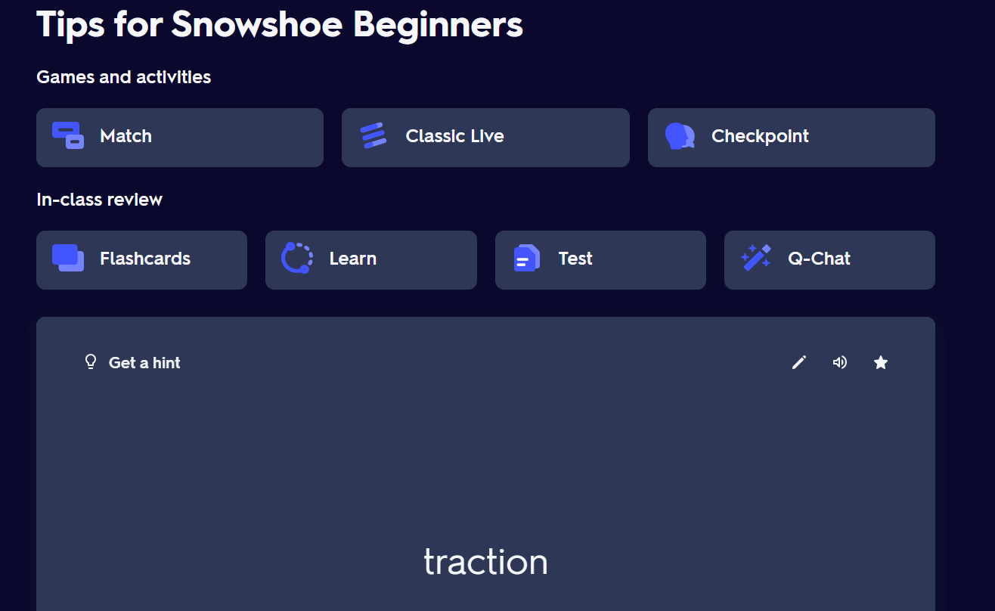
Lesson 2
Behaviorist – drill and practice with vocab
Gamification
Summative assessment
Listening – comprehending information
Notes:
Slide 8: The listening will be a summative assessment for this one. This is a picture of the quizlet I made, overall the students like the flashcard feature and when we do the classic live they have fun with the gamification of it.

Slide 9
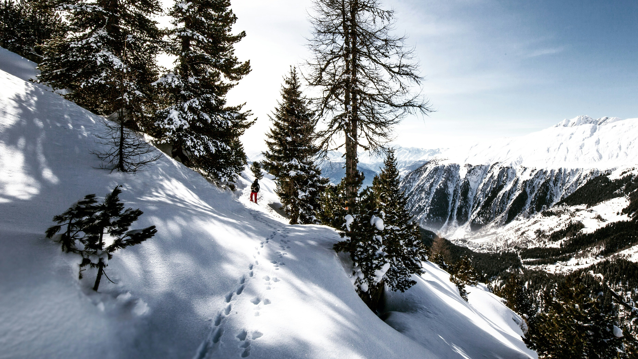
Lesson 3
Snowshoes and Snowshoeing in Canada
Real world website - The Canadian Encyclopedia
Microsoft Forms
Focus on reading skill
Photo by Dino Reichmuth on Unsplash
Notes:
Slide 9: Lesson 3 has a reading focus on snowshoes and snowshoeing in Canada. I use the website The Canadian Encyclopedia – we did this one last week and I showed the students how to use the hyperlinks to find out more about some words they came across that they didn’t know.

Slide 10
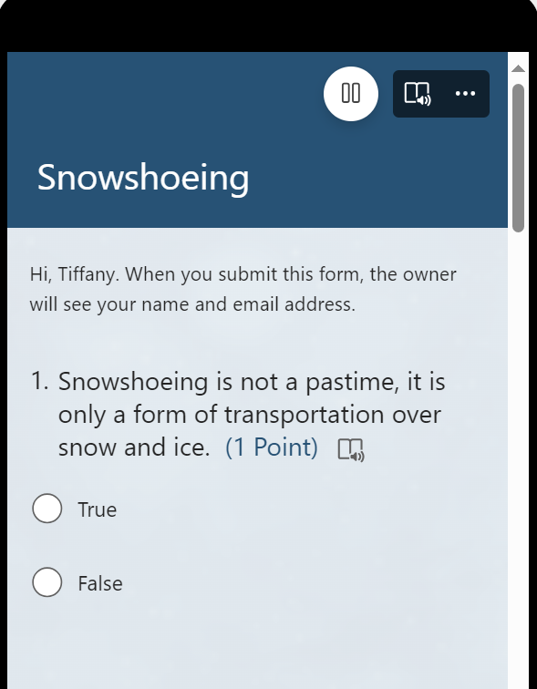
Lesson 3
Constructivist – adding new information to their existing knowledge, reflecting, building more understanding
Formative assessment
1st reading together
Summative assessment
2nd Reading – reading for details

Slide 11
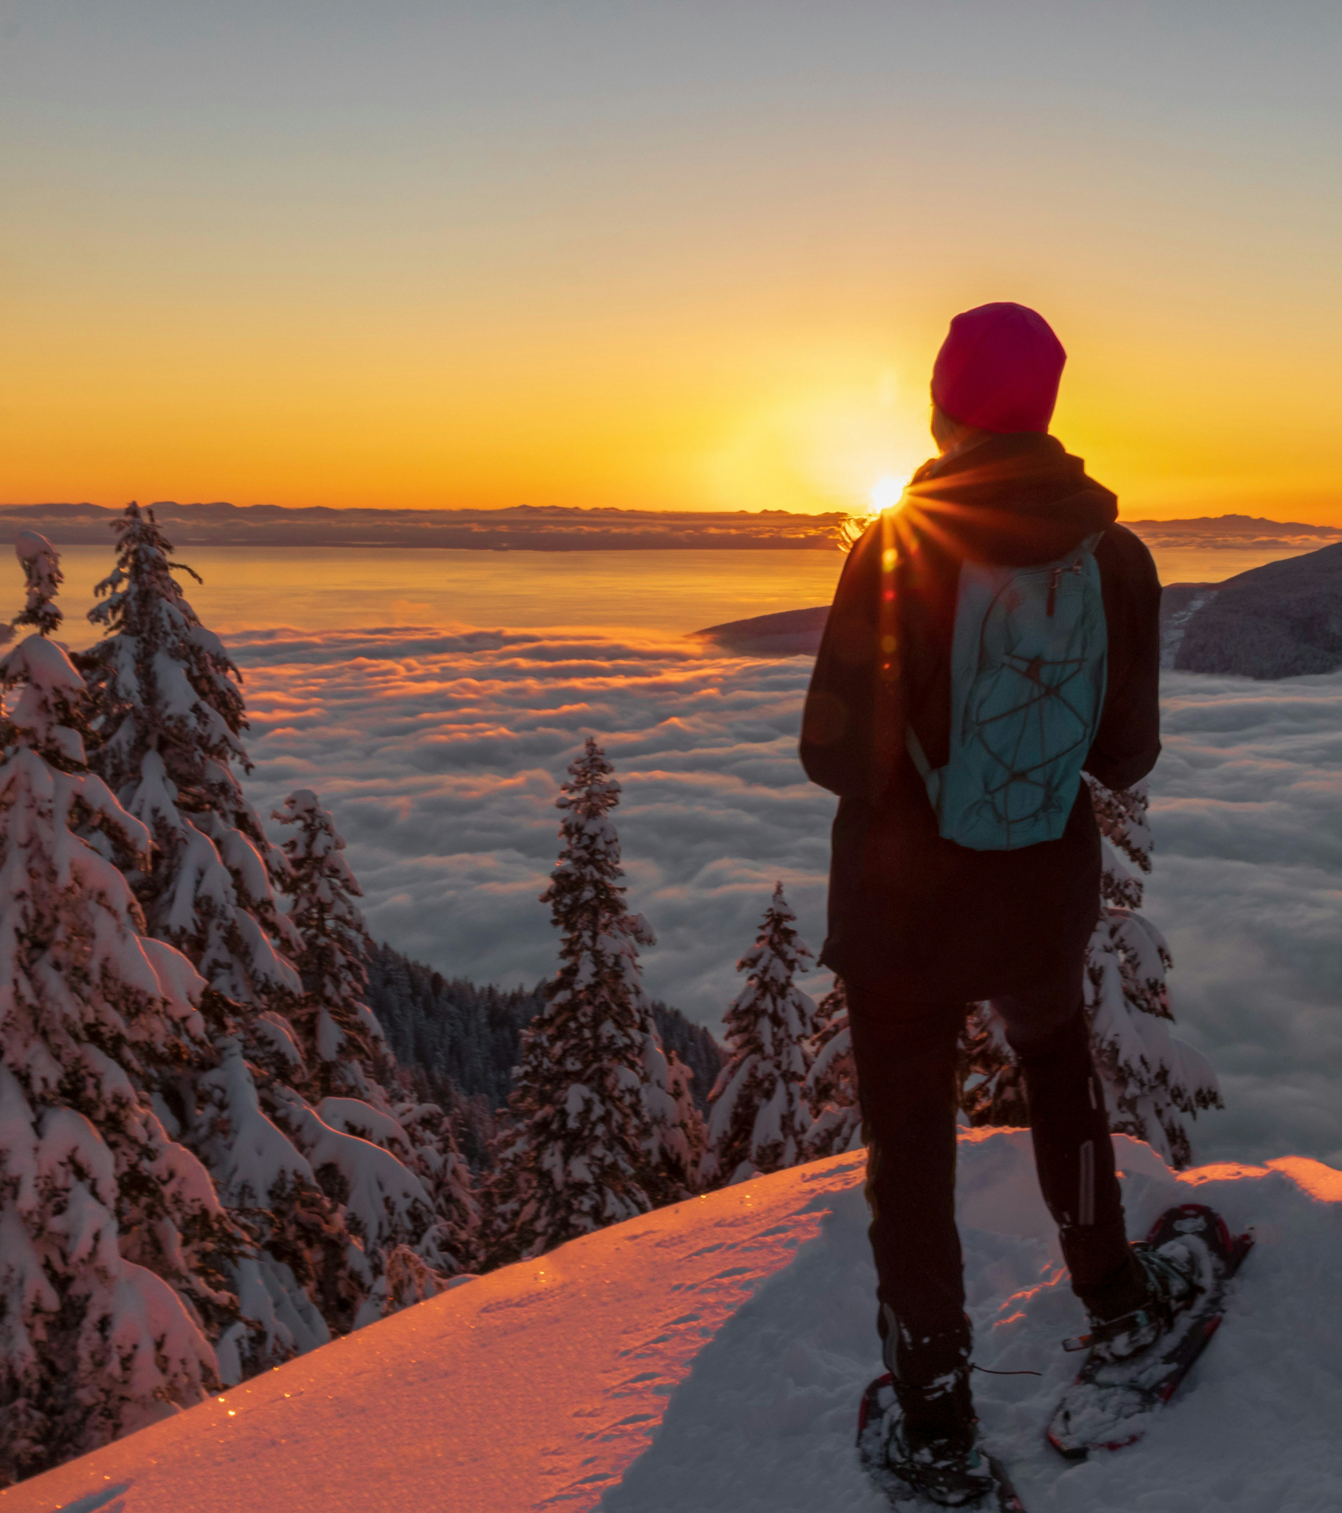
Lesson 4
What Should You Do?
Real world website – Grouse Snowshoe Trails
Padlet
Focus on speaking and writing skills
Photo by Susan Flynn on Unsplash
Notes:
Lesson 4 – What should you do? This one focuses on speaking and writing skills. The first part uses the Grouse Mountain Trail map with questions, and the second part is the padlet. So a few people added some ideas to the snowshoeing problems, thanks so much I would like to get a few more ideas and give you just a quick chance to chat with a group about one of the situations, so in a moment I will stop sharing my screen, I will put you into groups and I will give you a few minutes with your group to discuss and add some ideas for the problem situation that corresponds to your group – they are numbered 1-4. I will put the link in the chat.

Slide 12
Lesson 4
Cognitivist – Using critical thinking to solve problems
Summative assessment
Speaking – interacting with others
Notes:
Slide 12: Welcome back, so at this point the students will have their field trip and they will have a chance to ask the guide about anything we are unsure of from the problem situations.

Slide 13
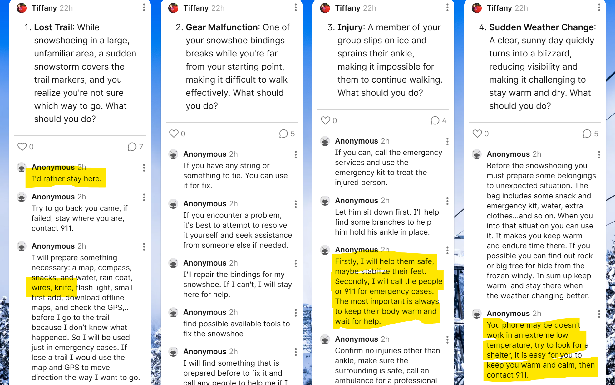

Slide 14
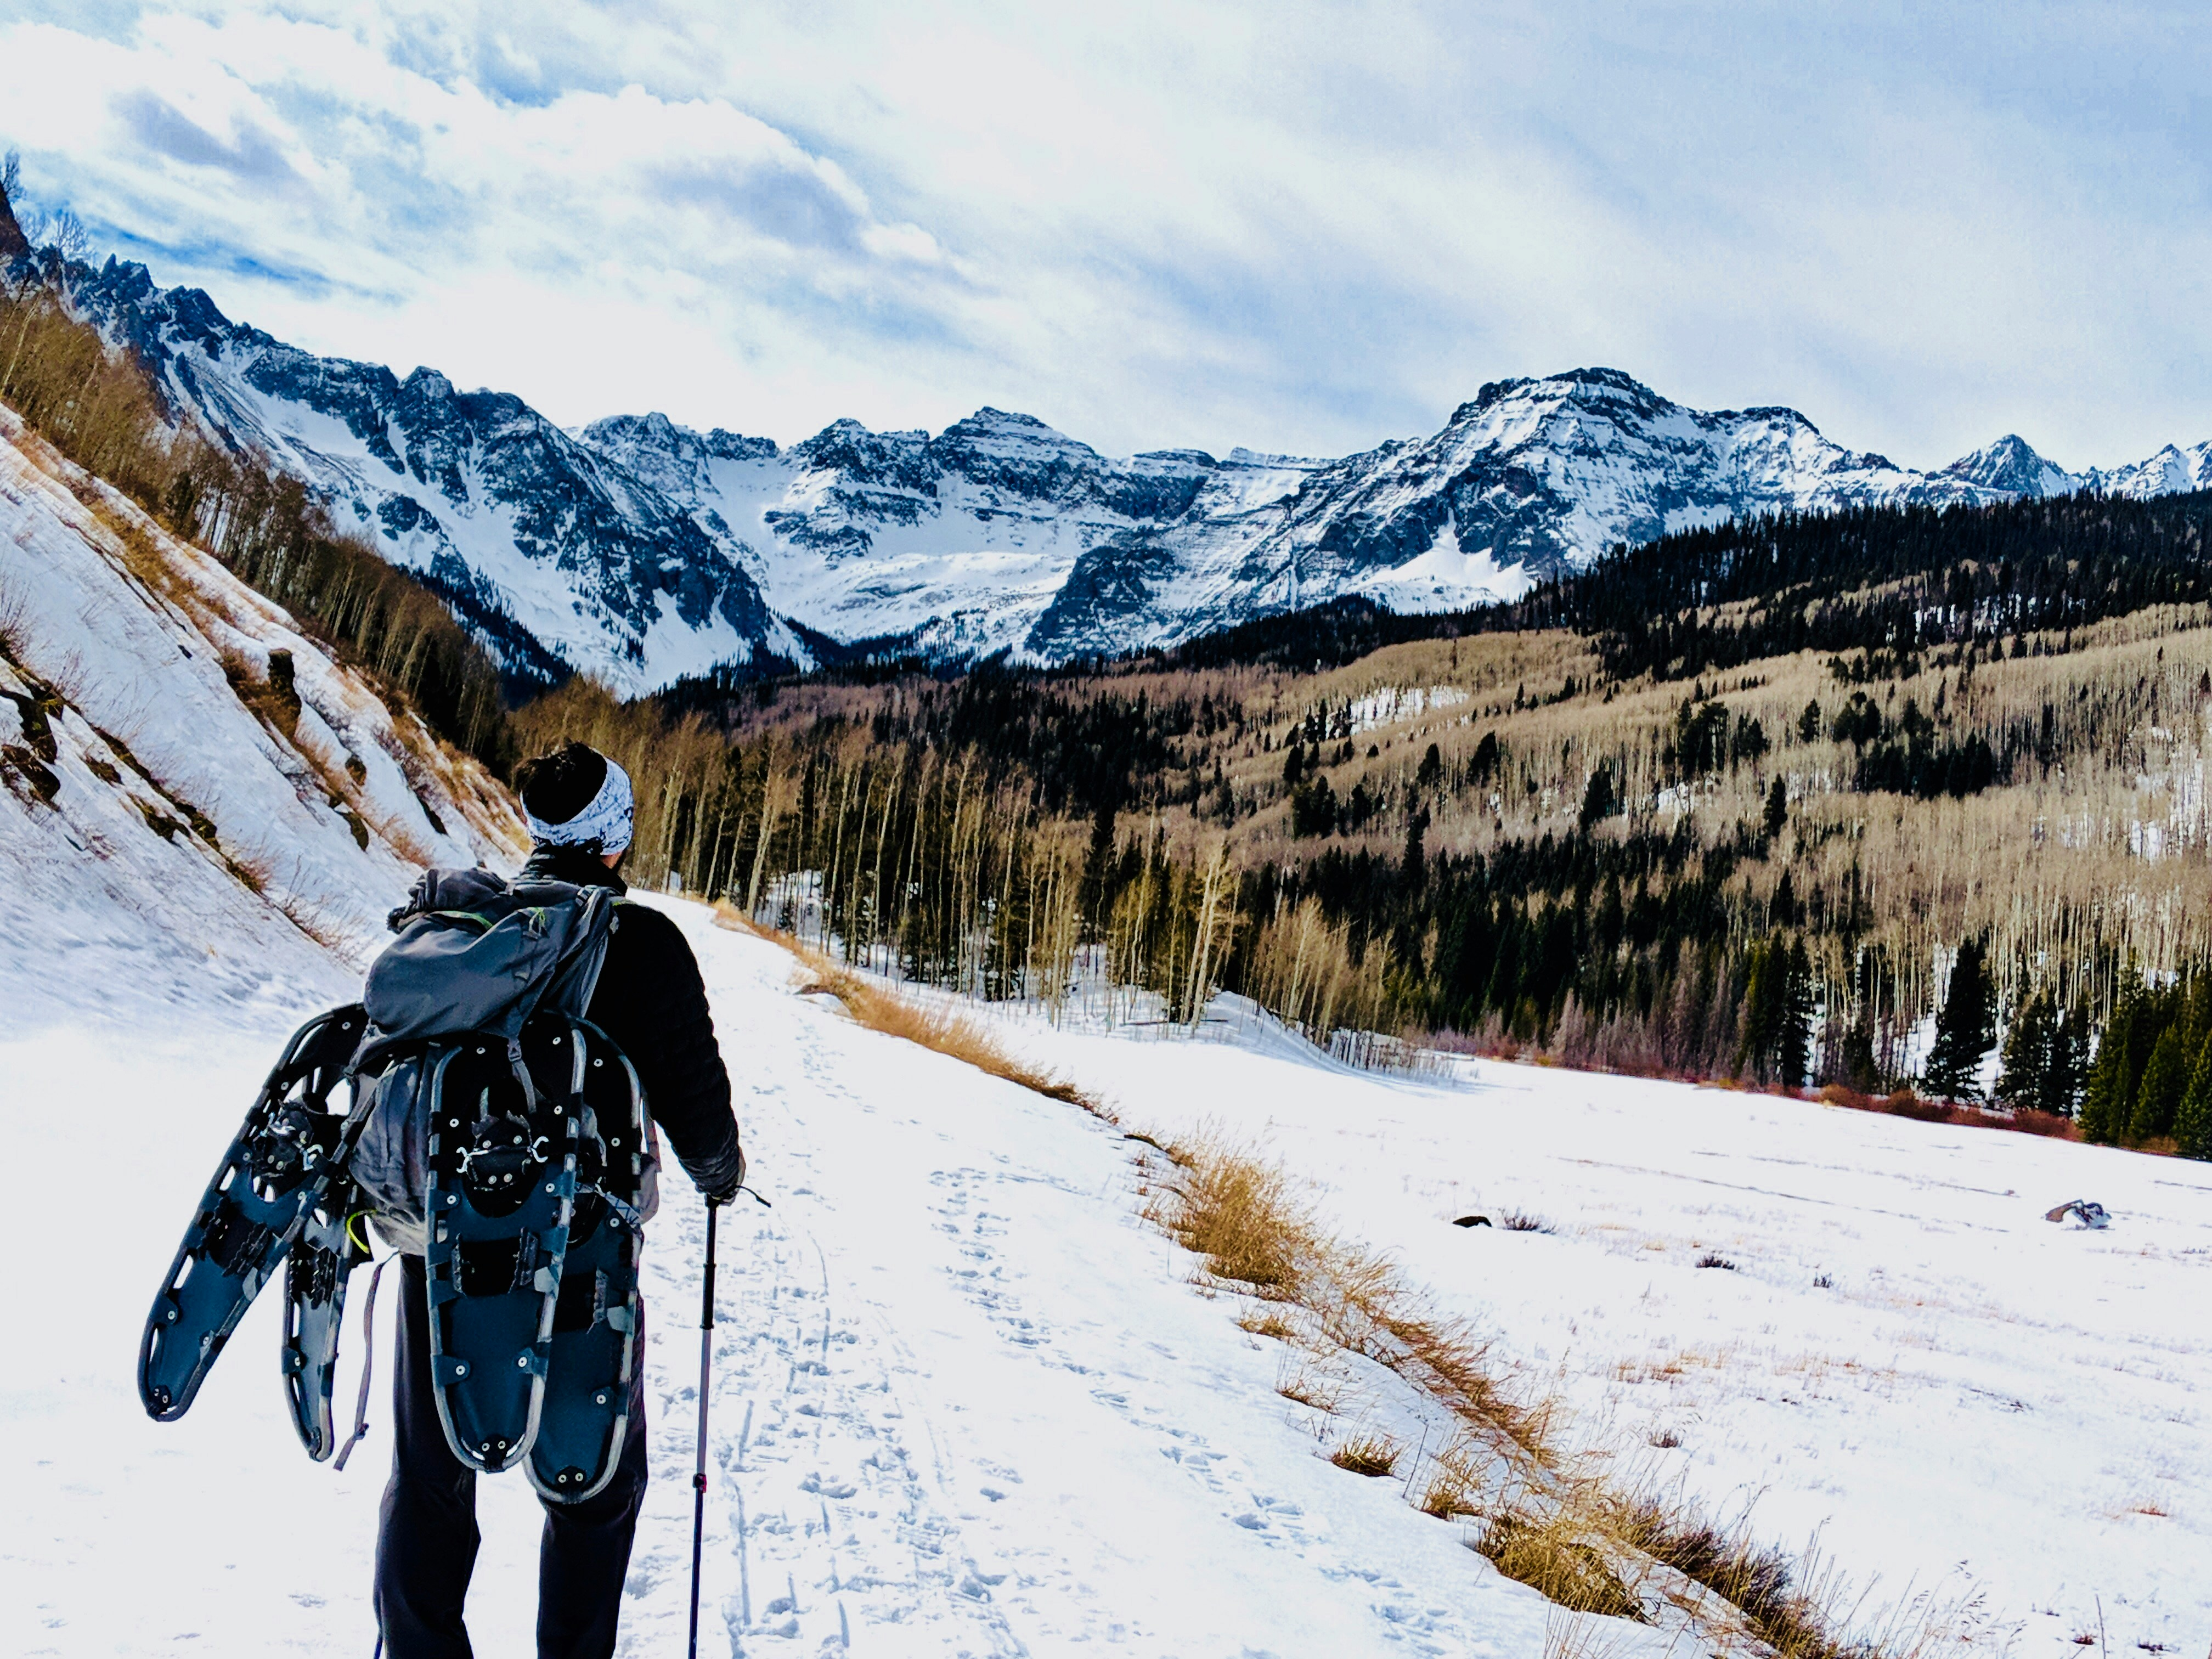
Lesson 5
Photovoice Reflection – After the Trip
Why Photovoice?
Focus on writing
Real World
Photos and posting comments on Microsoft Whiteboard
Photo by SivaSankara Reddy Bommireddy on Unsplash
Notes:
Slide 13: After the field trip, this is where I want to try out the photovoice experience share where students can post their photos on a Microsoft whiteboard to share and comment on each other’s posts.

Slide 15
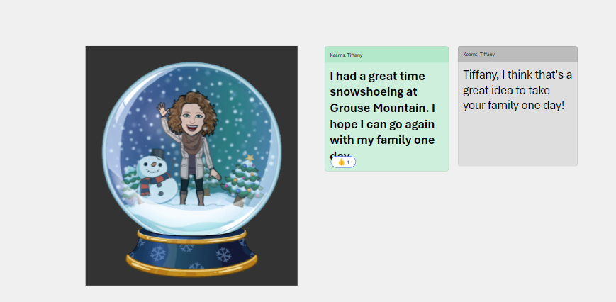
Lesson 5
Constructivist – reflecting on the experience
Connectivist – networking and connecting online
Summative assessment
Writing – sharing information and interacting with others
Notes:
Slide 14: I’ve planned for this writing and interaction to be a summative writing assessment, but it’s the first time that my students will use the whiteboard so there will be lots of formative assistance too.

Slide 16
Thank you
Feel free to check out my full learning design here on Microsoft Sway
Notes:
Slide 15: Thank you, if you want to check out the Sway with the full learning design, the link is on this page.

Slide 17
References
Bates, A.W. (2019). Teaching in a Digital Age – Second Edition. Vancouver, B.C.: Tony Bates Associates Ltd. Retrieved from https://pressbooks.bccampus.ca/teachinginadigitalagev2/
Chametzky, B. (2018). The Interconnectedness of Learning: How Andragogy Can Improve the Online Learning Experience. 4(4).
FSN Network (Director). (2022, December 20). qualKit: Photovoice. https://www.youtube.com/watch?v=PnCdzTS4b10
Government of Canada. (n.d). Canadian Language Benchmarks: English as a second language for adults. Retrieved from
Canadian Language Benchmarks,language-benchmarks.pdf (canada.ca)
Knowles, M. S., Holton, E. F., Swanson, R. A., & Robinson, P. A. (2020). The adult learner: The definitive classic in adult education and human resource development (Ninth editon). Routledge.
Lauckner, H., Gallant, K., Akbari, M., Tomas, G., nee White, T. P., & Hutchinson, S. (2022). Picturing Recreation: Newcomers’ Perspectives on Experiences of Recreation. Journal of International Migration and Integration, 23(4), 2101–2123. https://doi.org/10.1007/s12134-021-00921-2

